Slide 1

DiabetaRec
04.21.2025
A Personalized, Diabetes-Aware Recipe Recommendation System using Machine Learning and Generative AI
CSYE 7380 - Theory & Prac App AI Gen Model College of Engineering, Northeastern University
Jiaxian Li, Yiwen Kang

Slide 2
Agenda
CSYE 7380 - Theory & Prac App AI Gen Model College of Engineering, Northeastern University
1.
Problem Understanding and Definition
2.
Model/Framework Selection & Implementation
3.
Model Interpretation
4.
Creativity and Innovation

Slide 3
CSYE 7380 - Theory & Prac App AI Gen Model College of Engineering, Northeastern University
Problem Understanding and Definition
🔹 Problem Statement
Diabetes requires personalized dietary planning
Existing systems lack health-aware, preference-driven recommendations
Goal: Predict diabetes risk and recommend recipes accordingly
🔹 Approach Overview
Supervised ML predicts diabetes from structured health data
LLM + MCP extracts user food preferences from natural language

Slide 4
CSYE 7380 - Theory & Prac App AI Gen Model College of Engineering, Northeastern University
Problem Understanding and Definition
🔹 Target Variable
Diabetes status：Binary classification: 0 = non-diabetic, 1 = diabetic
food preference scores： (per category, range: –5 to +5)
🔹 Key Features
Health data: Glucose, BMI, Age, Pregnancies
User intent: Processed via MCP to get structured food preference scores
🔹 Framing
Supervised Learning for prediction
Prompt Engineering with MCP for user input parsing and response generation

Slide 5
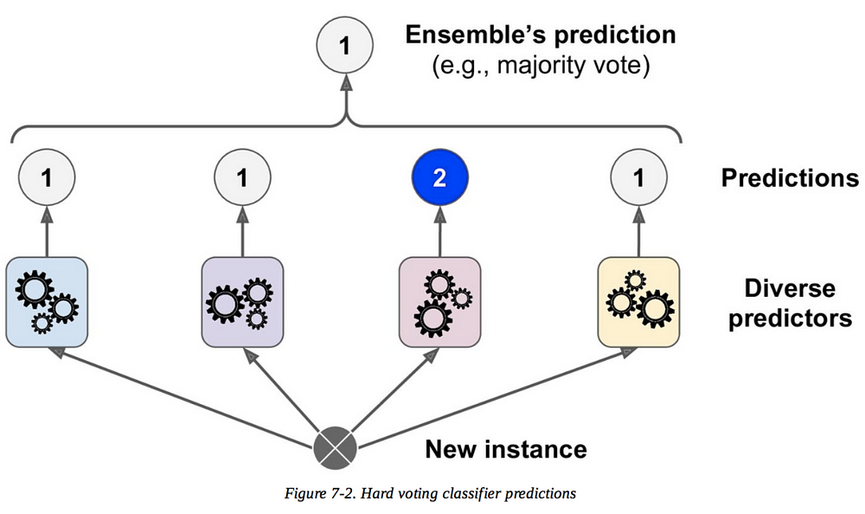
CSYE 7380 - Theory & Prac App AI Gen Model College of Engineering, Northeastern University
Model/Framework Selection & Implementation
🔹 ML Pipeline for Diabetes Prediction
SMOTE for class balancing
Ensemble via soft voting + stacking
Models: Decision Tree, GaussianNB, KNN, Logistic Regression, SVM, MLP
1
1
1
1
0

Slide 6
CSYE 7380 - Theory & Prac App AI Gen Model College of Engineering, Northeastern University
User Input (Text)
Model/Framework
Selection & Implementation
LLM + MCP Prompt
🔹 LLM for User Preference Extraction
GPT-based model parses natural language
MCP ensures structured, controllable output
Returns scores for 13 food categories (–5 to +5)
JSON output:
category_scores
reasoning
Input scores as weight
Weighted Recipe Scoring (from CSV)
Uses diabetic_friendly, category_scores
Top Recipes (suitable / not)
LLM: Final Recommendation
Using MCP context & recipe

Slide 7
CSYE 7380 - Theory & Prac App AI Gen Model College of Engineering, Northeastern University
Model/Framework Selection & Implementation
🔹 Workflow Integration
ML prediction → preference scoring → recipe filtering
Joint decision logic for final recommendation
🔹 Programming Stack
Python, Scikit-learn, imbalanced-learn
OpenAI API for LLM
GUI built with Gradio
User Input
ML Prediction
Parse
GUI Output
LLM
Preference Scores
Recipe Database
Recommendation Logic
MCP

Slide 8
CSYE 7380 - Theory & Prac App AI Gen Model College of Engineering, Northeastern University
Model Interpretation（Machine Learning）
🔹 Model Performance
Removed low-correlation features ( |r| < 0.2)
SMOTE enhances recall for minority (diabetic) class
Ensemble models outperform individual ones in both AUC and AUPR
Stacking improves prediction stability across folds

Slide 9
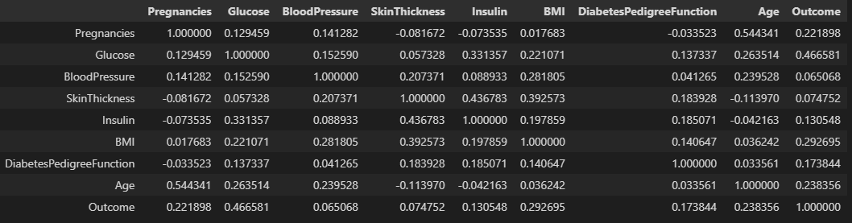
CSYE 7380 - Theory & Prac App AI Gen Model College of Engineering, Northeastern University
Model Interpretation（Removed low-correlation features）
🔹 Removed low-correlation features ( |r| < 0.2)

Slide 10
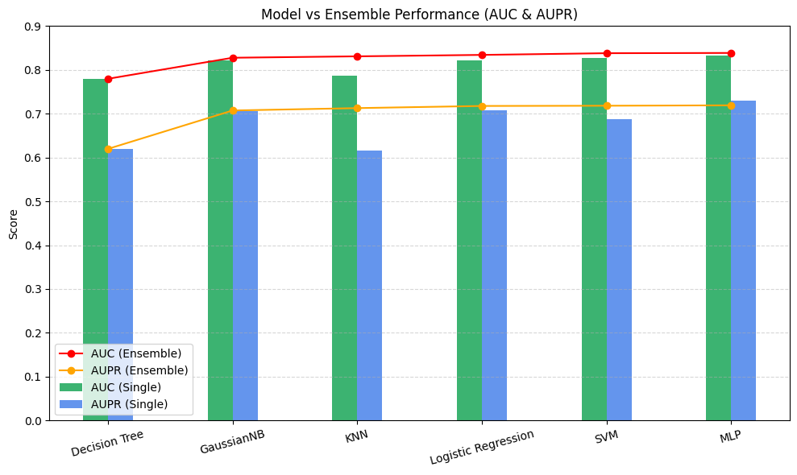
CSYE 7380 - Theory & Prac App AI Gen Model College of Engineering, Northeastern University
Model Interpretation（Ensemble models）
🔹 Ensemble models outperform single classifiers in AUC and AUPR, providing more reliable predictions.

Slide 11
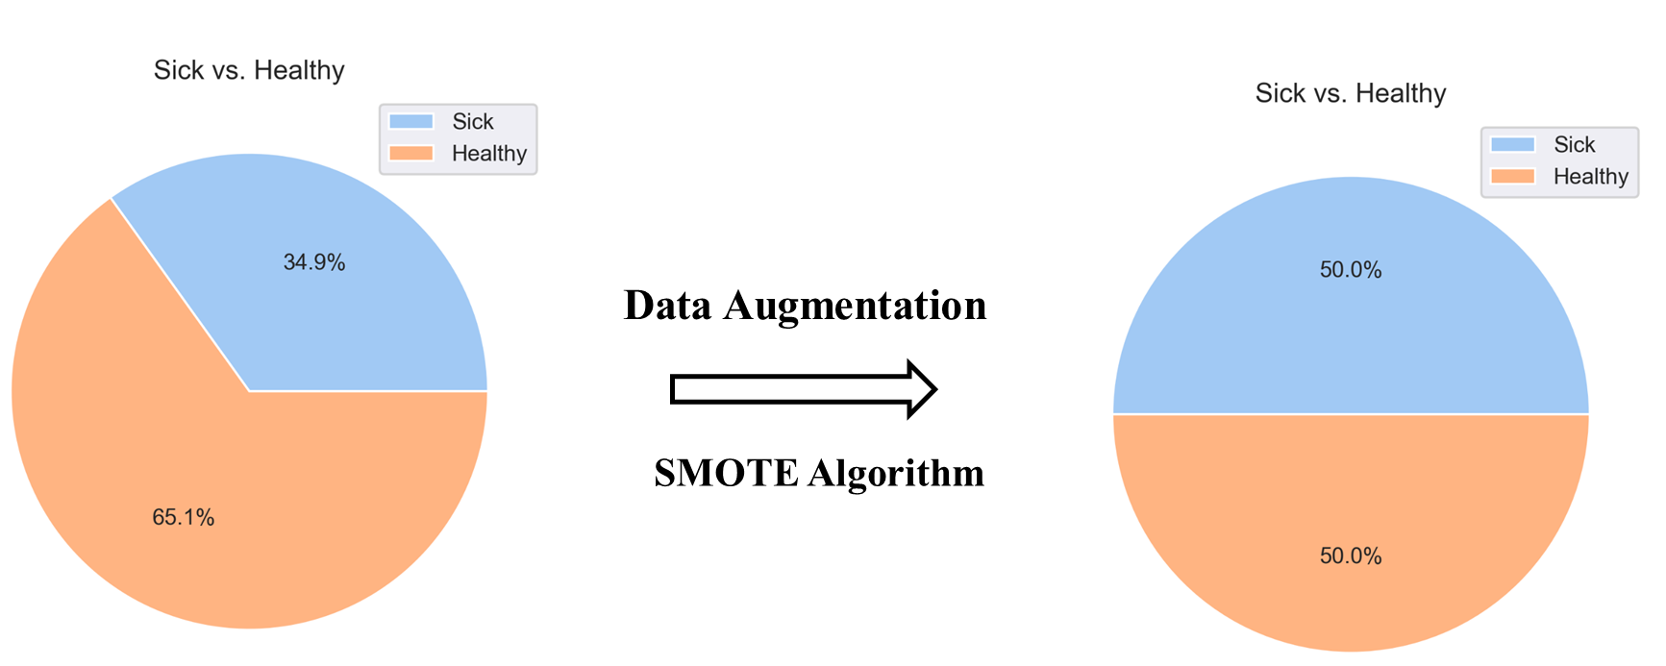
CSYE 7380 - Theory & Prac App AI Gen Model College of Engineering, Northeastern University
Model Interpretation（SMOTE）
🔹 SMOTE (Synthetic Minority Over-sampling Technique) helps balance the dataset by generating synthetic samples for the minority class, improving model performance on imbalanced data.

Slide 12
CSYE 7380 - Theory & Prac App AI Gen Model College of Engineering, Northeastern University
Model Interpretation（LLM + MCP）
🔹 Interpretable Output from LLM
MCP ensures structured, score-based food preference output
Category scores (–5 to +5) reflect user intent clearly
Includes reasoning to explain recommendations

Slide 13
CSYE 7380 - Theory & Prac App AI Gen Model College of Engineering, Northeastern University
Model Interpretation（apps use cases）
🔹 User-Facing Explanation via GUI
GUI shows predicted risk and recommended recipes
Clearly separates suitable and not-suitable options
Enhances transparency for end users

Slide 14
CSYE 7380 - Theory & Prac App AI Gen Model College of Engineering, Northeastern University
Creativity and Innovation
🔹 MCP + LLM Preference Scoring
Used Model Context Protocol to extract structured scores from natural language
Enables controllable, explainable generative output – beyond simple prompting
🔹 Two-Stage Recommendation Logic
Combined ML-based health risk prediction with LLM-based user intent parsing
Joint scoring mechanism ensures both health-aware and preference-driven filtering
🔹 Diabetic-Specific Recipe Filtering
Added logic to flag and display “not suitable” recipes for awareness
Rarely seen in typical recommendation systems
🔹 Fully Functional GUI
Built an interface that non-technical users can interact with
Integrates ML, LLM, and recommendation results in one place

Slide 15
Thanks for Your Attention

